Slide 2
All I want for Christmas is
… LabVIEW with friends

Slide 3
Advent of Code
Using LabVIEW

Slide 4
Agenda
About Me
What is Advent of Code
How it works
AoC & LabVIEW
What you’ll learn
What is it used for
Join us
Google Chrome extensions
Speed Tricks
Some examples

Slide 5



About Me
Stefan Lemmens
Test development engineer at Jaga Climate Designers
LabVIEW Developer since 1999 (LabVIEW 5.0)
LabVIEW Champion since 2021
Member of SAS LabVIEW Mastermind
Created a leaderboard on Advent of Code and Discord server for LabVIEW developers
LabVIEW shortcuts booklet
Mostly use Actor Framework (basics to PPL tutorial)
Mail : stefanlemmens.be@gmail.com
NI Forum : StefanLemmens
Twitter : @stefan_Lemmens

Slide 6


Slide 7

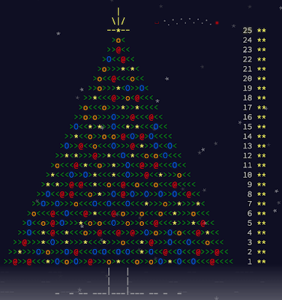
What is Advent of Code
An annual set of Christmas-themed computer programming challenges that follow an Advent calendar
The programming puzzles cover a variety of skill sets and skill levels
Can be solved using any programming language (or directly on hardware like fpga)
Participants also compete based on speed on both global and private leaderboards.

Slide 8
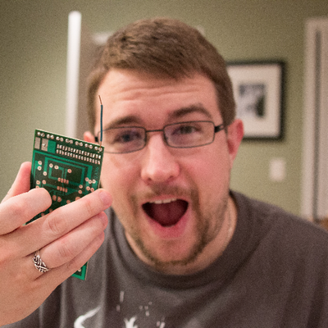
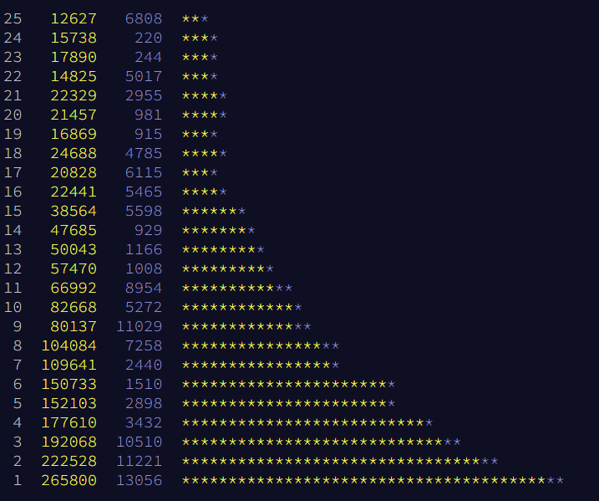
History
Created by Eric Wastl in 2015
For his friends (and their friends)
Aimed at about 50 people?
Already had 4.000 people at 1st December 2015
Hit 1.000.000 registered users in 2022
Stats 2022

Slide 9
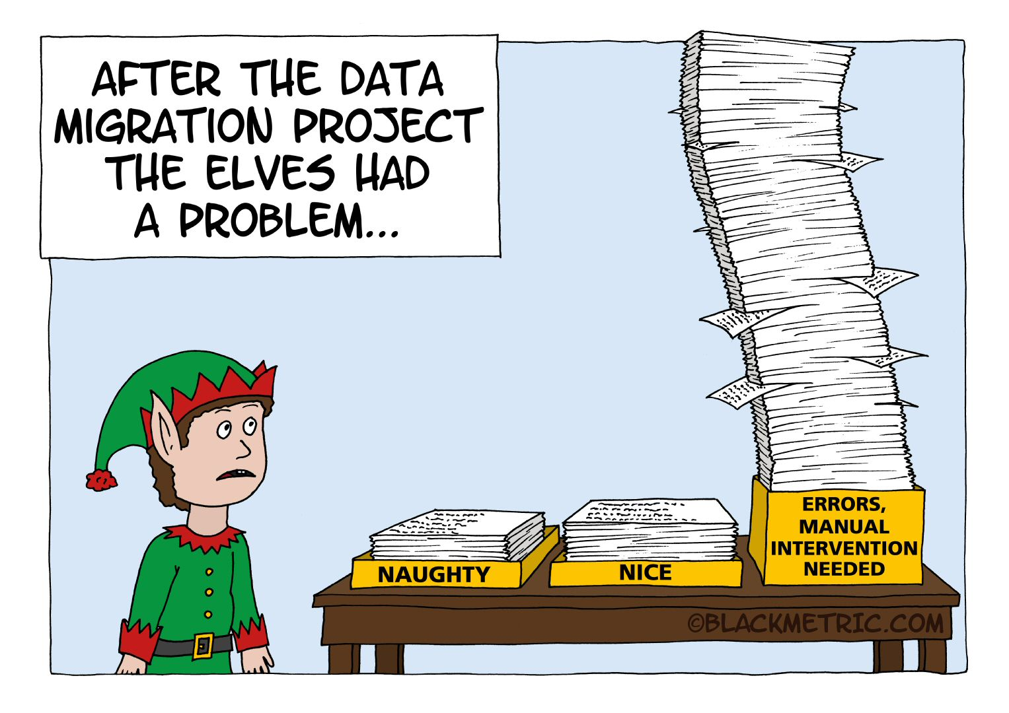
How it works
Every day a puzzle unlocks at midnight EST (UTC-5) which is 6am CET
You always need to help santa’s elves to save Christmas
Each puzzle has 2 parts
Need to solve part 1 before part 2 unlocks
Part 2 contains either continuation or twist
Score points on the leaderboard
Small example is given
Perfect for using TDD
Only need to enter your solution
Locks if incorrect
Lots of different inputs
Balanced: more difficult in weekends

Slide 10
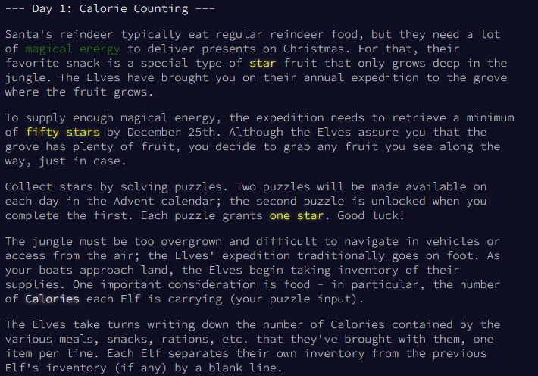
How it works

Slide 11
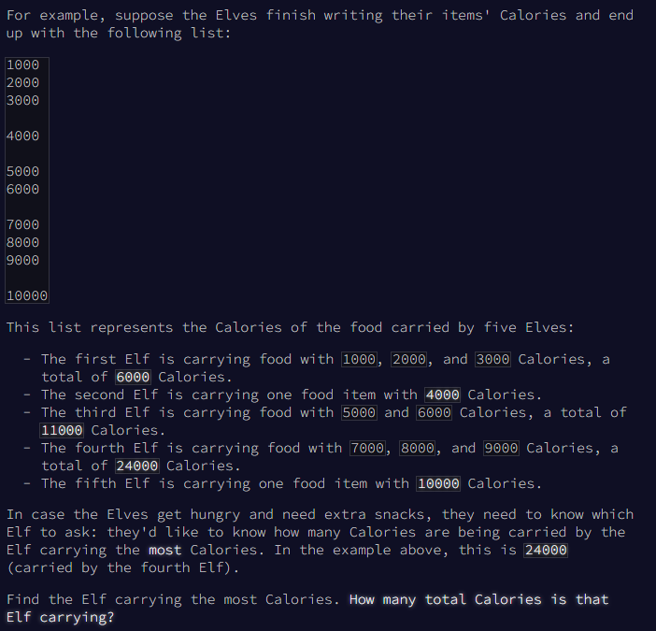
How it works

Slide 12
AoC & LabVIEW
As a language
Can be solved using any programming language
Advantage of LabVIEW is the visualization
As a community
Best community there is
Friendly competition
Discord server to discuss problems and solutions
2021 : 29 active participants
2022 : 49 active participants
2023 : ???

Slide 13

What You’ll Learn
How others solve problems in a different way
Test Driven Development
Regular Expressions
Sets and Maps
Recursion
Memory management
Algorithms
Golden nuggets and hidden gems
Meet new LabVIEW friends on the Discord

Slide 14

What is it used for
Interview preparation
Job interviews
Company training
University coursework or exams
Practice problems
Speed contest
Friendly challenges
A lot of FUN

Slide 15

Join us
Discord Server
https://discord.gg/AgKWURdGak
Leaderboard
Go to https://adventofcode.com/
Select [Log In] in the top menu
Identify yourself using 1 of the suggested services (you only have to login to that service the first time; this uses OAuth). Possible services are [GitHub] [Google] [Twitter] [Reddit]
Once you're logged in your name/nickname will appear at the right top of the "menu"
Select [Leaderboard] in the top menu
Select [Private Leaderboard] in the description
Enter the code for the LabVIEW leaderboard and select [Join] : 987334-ea1e3697
Now you can see the leaderboard and check that your name is on there
Select [Leaderboard] in the top menu
Select [View] for the leaderboard with my name "Stefan Lemmens"

Slide 16
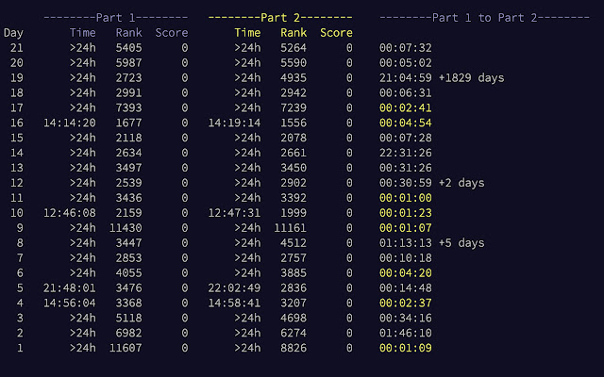
Google Chrome Extensions
Advent of Code Part 2 Timer
Add a column to the personal stats page which displays how long it took you to get from part 1 to part 2

Slide 17
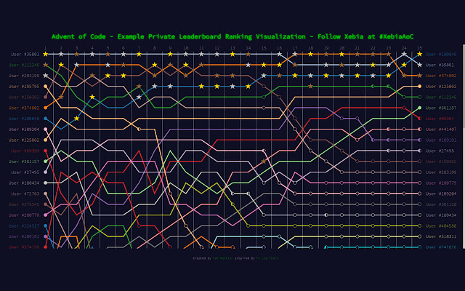
Google Chrome Extensions
Advent of Code Ranking
Visualize the ranking over time of a Advent of Code private leaderboard

Slide 18
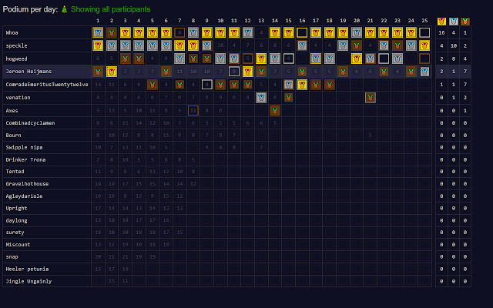
Google Chrome Extensions
Advent of Code Charts
Inject charts in your private leaderboard page for Advent of Code

Slide 19
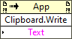
Speed Tricks
Read the question well
Create VM with LabVIEW Community Edition
Send result to clipboard
Get input directly from url
curl https://adventofcode.com/2022/day/%d/input --cookie "session=%s“
Where %d is the daynumber and %s is your session cookie.
If you don't know where to get the session cookie here's a page that explains it
https://github.com/wimglenn/advent-of-code-wim/issues/1

Slide 20
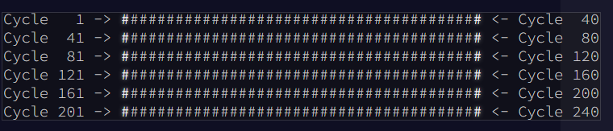
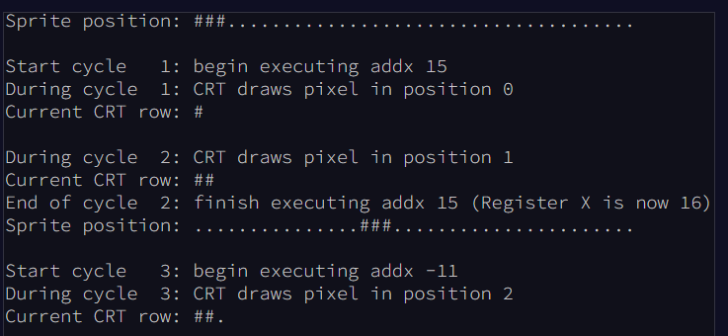
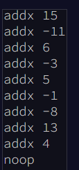
Examples
Day 10 2022
Draw a sprite on a CRT tube
Draw only if the calculated position matches the current cycle

Slide 21
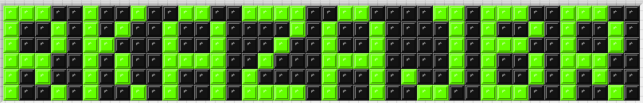
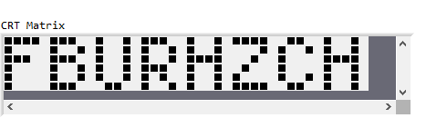
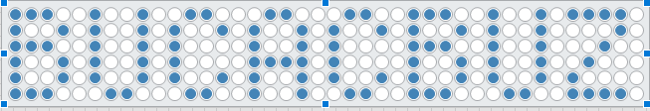
Examples
Day 10 2022

Slide 22
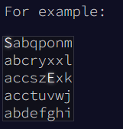
Examples
Day 12 2022
Height map indicated with characters
Get from S to E in as few steps as possible (part 1)
Move max 1 step up, unlimited steps down
Find the best possible a to start from and reach E in as few steps as possible

Slide 23
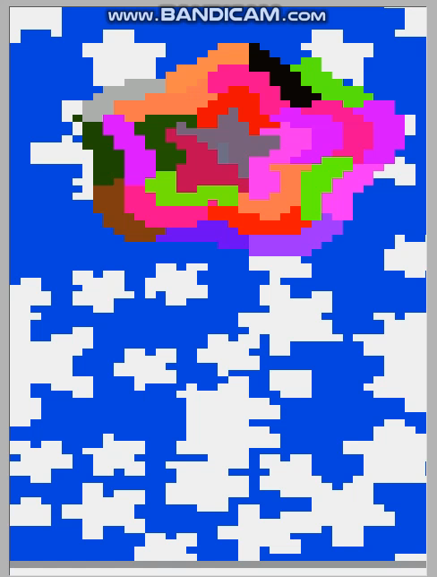
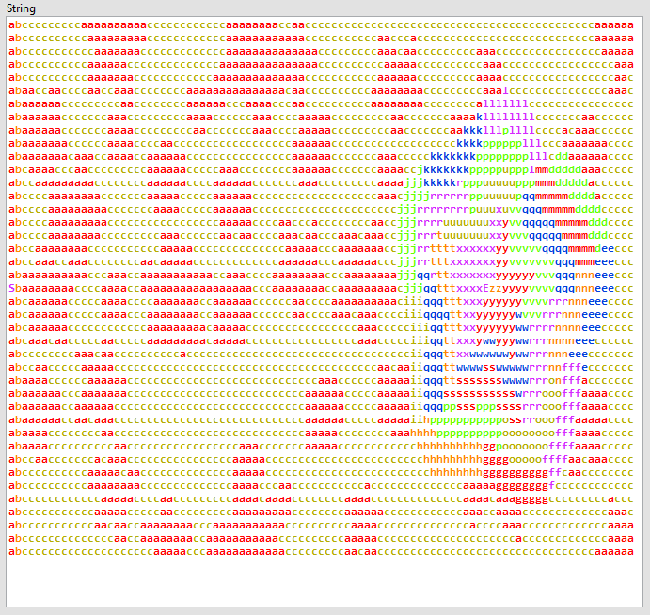
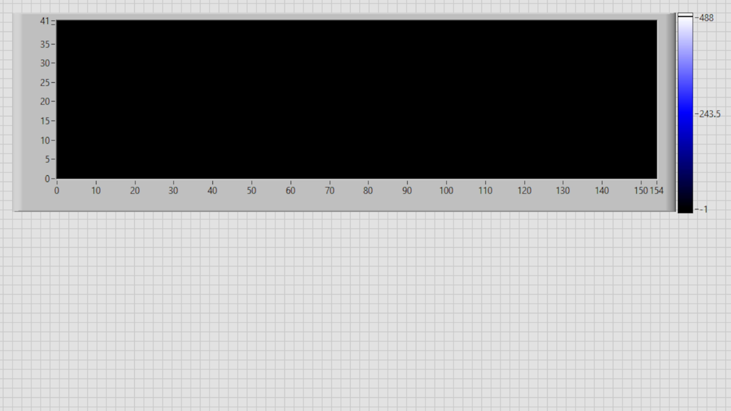
Examples
Day 12 2022

Slide 24
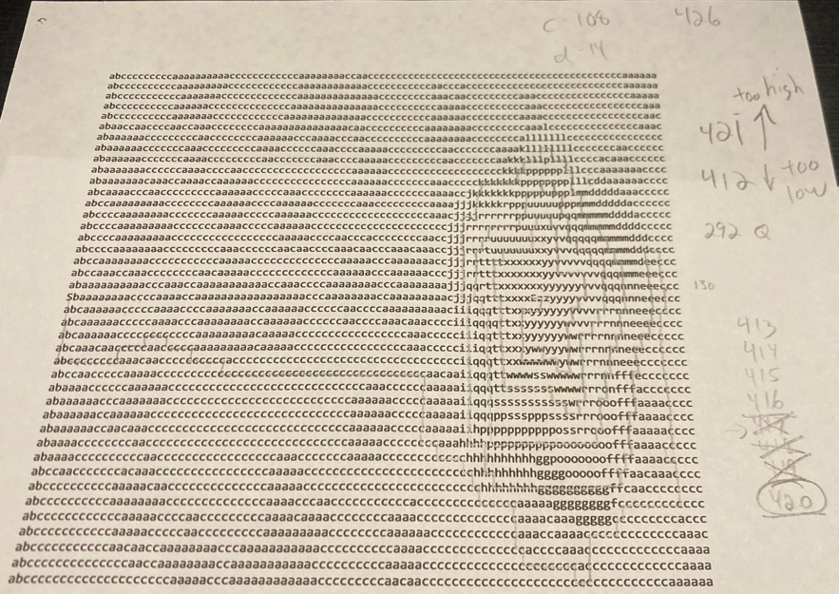
Examples
Day 12 2022

Slide 25
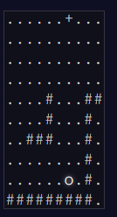
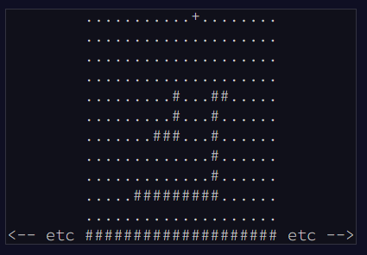
Examples
Day 14 2022
Falling sand
When falls the first sand into the abyss (part 1)
When gets the sand gun blocked (part 2)

Slide 26
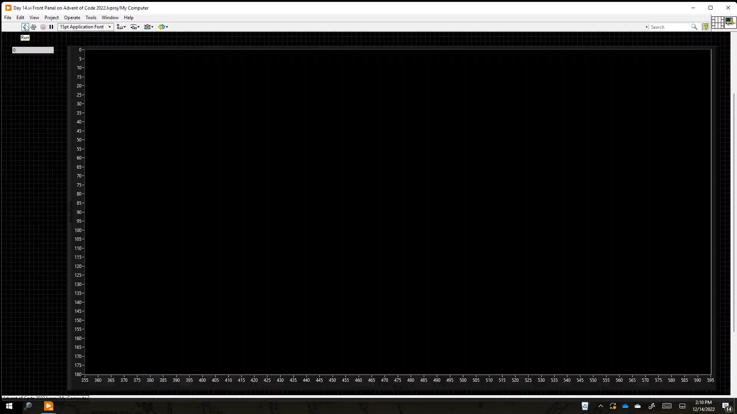
Examples
Day 14 2022

Slide 27
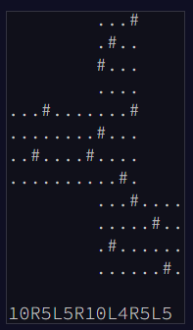
Examples
Day 22 2022
Move on a flat map (part 1)
Move on a cube (part 2)

Slide 28
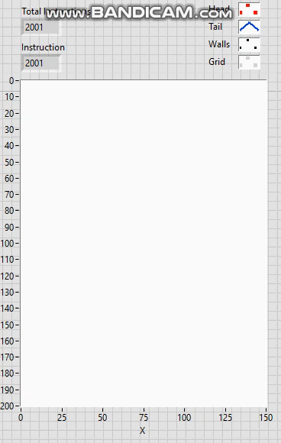
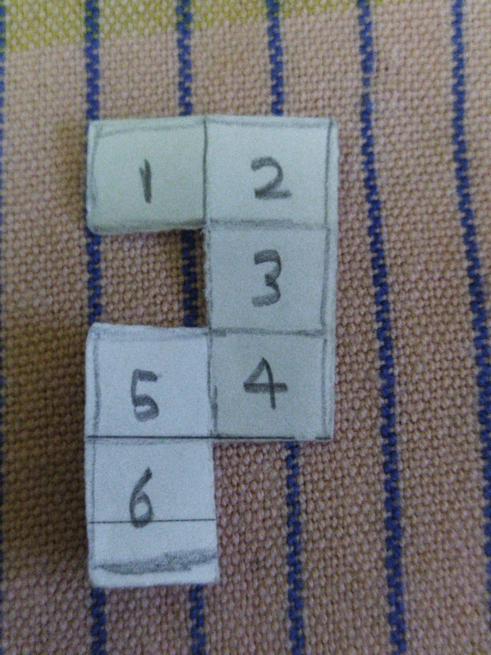
Examples
Day 22 2022

Slide 29

Disclaimer
I’m not responsible for the time it takes you to solve the puzzles
nor for any discontentment at home.

Slide 30
Advent of Code - LabVIEW
Website : https://adventofcode.com/ LabVIEW Leaderboard : 987334-ea1e3697
Discord Server : https://discord.gg/AgKWURdGak

